Slide 1
Title Slide
Name: Hamza Jadoon
Registration No.: FA22-BCE-012
Title: Data Management
Course Name: Data Structures & Algorithms
Submitted to: Sir Bicktash Ali Jehangir

Slide 2
Introduction
Overview:
In this project, we implemented a program to manage data records consisting of a Name, Contact, and Address. The program supports operations such as insertion, searching, retention in secondary memory, and loading from a data file on disk. We utilized four different data structures for the implementation: Singly Linked List, Doubly Linked List, Stack, and Queue. The primary objective was to compare the performance parameters of these data structures in handling the specified operations.
Objective of the project.
Implement data management using Singly Linked List, Doubly Linked List, Stack, and Queue.
Compare the performance of these data structures in terms of insertion, search, and file I/O operations.
Retain data in secondary memory and load it back into the data structures.
Key operations: insertion, search, retention in secondary memory, and loading from a data file.

Slide 3
Purpose and Objectives
Purpose:
To explore and compare the efficiency of different data structures in managing data records.
Objectives:
Implement data management using Singly Linked List, Doubly Linked List, Stack, and Queue.
Compare performance in terms of insertion, search, and file I/O operations.

Slide 4
Data Structures Overview
Singly Linked List: Insertion at the end.
Doubly Linked List: Insertion at the beginning.
Stack: LIFO (Last In, First Out) structure.
Queue: FIFO (First In, First Out) structure (circular queue in this case).

Slide 5
Singly Linked List
Insertion: Nodes are added at the end.
Search: Linear traversal to find a record.
File Operations:
Retention: Save to file.
Loading: Load from file.

Slide 6
Doubly Linked List
Insertion: Nodes are added at the beginning.
Search: Linear traversal in both directions.
File Operations:
Retention: Save to file.
Loading: Load from file.

Slide 7
Stack
Insertion: Push operation adds nodes to the top.
Search: Linear traversal to find a record.
File Operations:
Retention: Save to file.
Loading: Load from file.

Slide 8
Queue (Circular Queue)
Insertion: Enqueue operation adds nodes to the rear.
Search: Linear traversal to find a record.
File Operations:
Retention: Save to file.
Loading: Load from file.

Slide 9
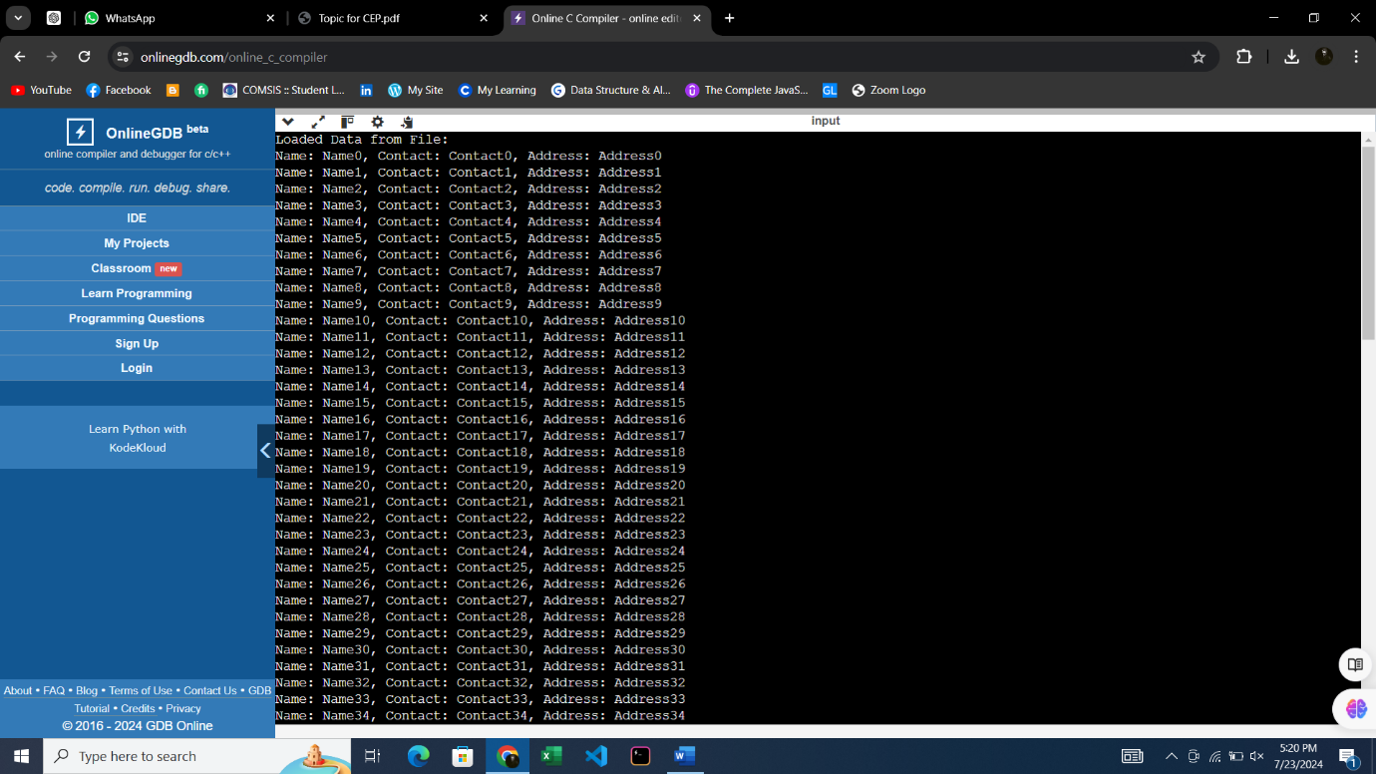
Output:

Slide 10
Conclusion
Summary:
Manually entering data will consume much time as we have to make 100 enteries in the code.
Recommendations for selecting data structures based on specific use cases.
Future Work:
Potential improvements and further research.

Slide 11
Thanks

